Slide 1
Sample Table Assignment
PrintNet T

Slide 2
Agenda
Introduction
Data Input
Data Processing
Layout
Impositioning and Output
Production

Slide 3

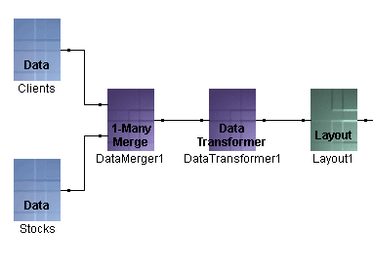
Introduction
The intention in this assignment is to input two .CSV data files, merge them with a 1-Many Merge module, transform them with a DataTransformer, and then use them in a Layout design, overflowing the content on to multiple pages of differing design.
Notes:
Throughout this training session, we will use two .CSV files merged with a 1-Many Merge module, then Transformed by a DataTransformer and used in Layout with overflowing pages.
This task ties in with the Basic Training pt.1, task A, Sample Letter. The steps described here assume that this task has been completed.
For more detailed information, see the .PDF file SampleTable Description.pdf – it should be supplied with the training. It contains a list of data fields, conversions, and properties, and also placement of data fields in Layout.

Slide 4
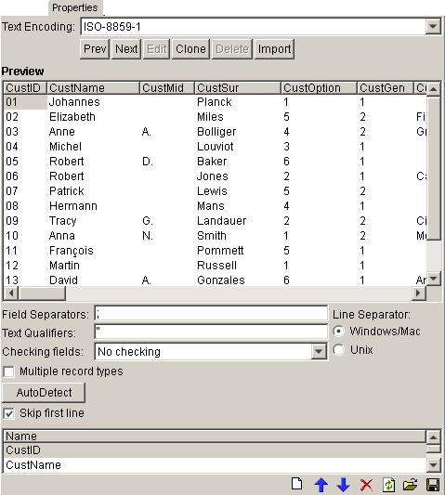
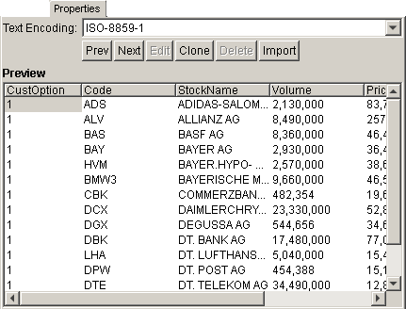
Data Input
Add two Data Input modules.
  In one, open FIIIF_Clients.csv with properties specified. Root Array Name: Clients.
  In the other, open FIIIF_Stocks.csv. Root Array Name: Stocks.
Notes:
CustOption will be the key field. It is present in both data files and we require certain information from Stocks when called by Clients, i.e., when CustOption has matching values in both data files.
There are two .CSV data files in the task folder provided. The FIIIF_Clients.csv file is the same list of clients as used in our first task Sample Letter the FIIIF_Stocks.csv gives stock price information for those people who have stock options.
1) Add the two data input modules.
Open the .CSV file FIIIF_Clients.csv in one. Enter the name Clients as the Root Array Name on the Input file tab of the Data input module and set .
Open the .CSV file FIIIF_Stocks.csv in the other. Root Array Name: Stocks.
The most significant field in both input files is the CustOption, which we will use as the key field to determine the relationship between the two files.
The relationship between the two files will be master (Clients) and slave (Stocks). The records from the master (Clients) have specified values for the CustOption field for each client and according to this value the matching records will be called from the slave (Stocks) file. E.g., for any Client having CustOption “1” marked in his or her record, then all of the records from Stocks that have the matching value for CustOption will be selected.

Slide 5
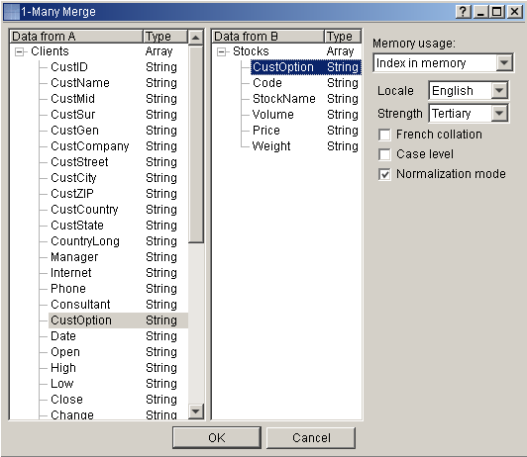
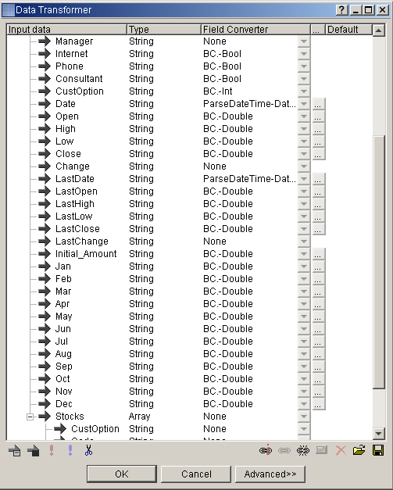
Data Processing
Add 1-Many Merge module and connect both Data Input modules to it.
Add the Data Transformer module and connect it.
Notes:
Add 1-Many Merge module and connect both Data Input modules to it.
Highlight field CustOption on both sides to create the relation between the files.
Add the Data Transformer module and connect it.
Apply the same transformations as for the task – A Sample Letter.
2) Add the 1-Many Merge module to the workflow and Connect the two Data Input modules to the left side of it. Master (Clients) must go to the top connector A and Slave (Stocks) to the bottom one B.
When the module is opened the Master fields are listed down the left side of its panel and the Slave field are listed down the right.
Select the CustOption field in both the left and right lists. They will be highlighted, denoting that they are the key fields.
Note: Fields do not necessarily need to have the same name (here they do, to make the sample clearer) for them to be linked.
3) Add the Data Transformer module to the workflow and connect it.
Apply the same transformations as for the task – A Sample Letter (details of the fields to transform are as visible in the screenshot on the slide and are also described in the PDF document SampleTable Description). No transformation is required for the field that are part of the Stocks input.

Slide 6
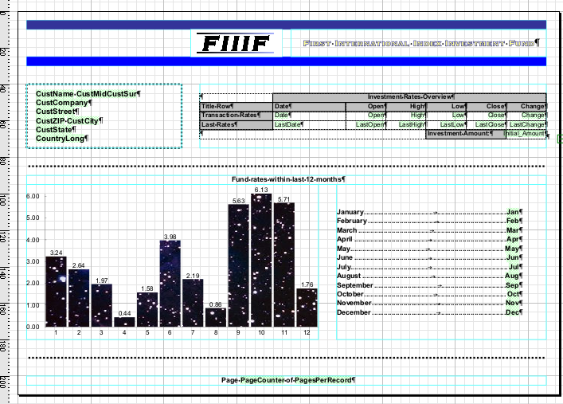
Layout – Landscape page
Notes:
On the slide here, we present the intended layout for this task. You can also refer to the ready prepared .PDF file included with the task (SampleTable.pdf) to see the intended result.
The front page of the mail to each client will be this landscape view including graphs; the remainder of the letter that the each client receives will be continued to a repeated content page which is portrait-oriented.
The first page consists of:
Heading part of the table, a simulation of a sample company’s paper header. It contains two frames, an image (logo) and the company name (fixed text) formatted with a special text style.
Client’s address area (variable), surrounded by rectangular shape with dotted outline.
Simple (non-overflowing) table with merged cells and table Styles.
Dotted outline separating the area with chart data.
Variable chart displaying values of the fund rates for the last 12 months.
The bars are filled with FillStyle.
Chart values are also displayed using paragraph formatting with Tabulator and dot leader.
Footer (of both pages) contains variables PageCounter and PagesPerRecord.

Slide 7
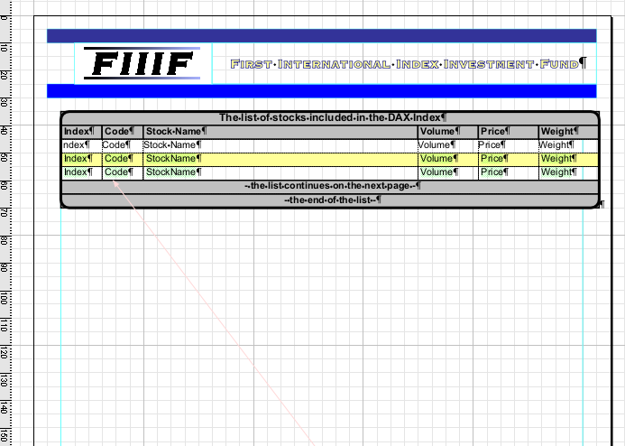
Layout – Portrait page
Notes:
The other pages that will make up this mail shot are a simple account statement made up of a table that has rows repeated by however many entries have been made in the data input file. This will carry also carry on to following pages of the same design, if required.
The heading part of the table, a simulation of a sample company’s paper header. This can simply be copied from the previous page and pasted using Enhanced Paste.
Overflowing table, having a repeated body row selecting rows with alternating color.

Slide 8
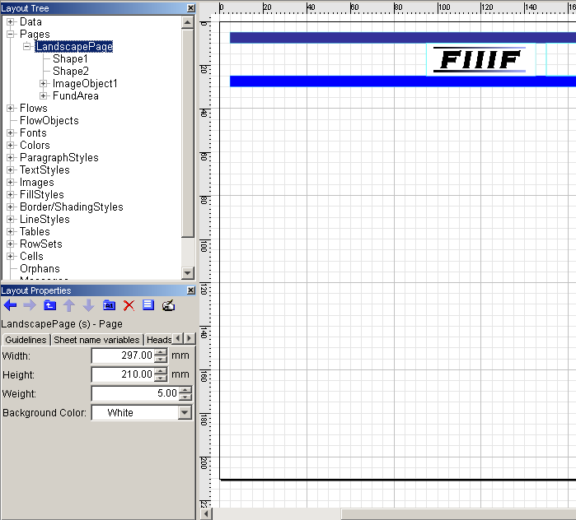
Layout – Create Page
Add the Layout Module to the workflow, open it and create a page. Rename it LandscapePage
Draw and arrange blue-filled rectangular shapes (using Shape tool) at the top of the page.
Insert image FIIIF.jpg and place it there.
Add a flow area between them, enter text and rename it to FundArea.
Notes:
4) Drag and drop a Layout Module to the Workflow Area and connect it after the Data Transformer module.
Create your landscape page (Page | Add New Page) and name it LandscapePage.
Give it Width: of 297mm and Height: 210 (as A4 landscape would be).
5) Place some simple objects:
Rectangles (made by the shape tool) for the header at the top of the page and edit the fill properties appropriately. For our example here, we have two blue-filled-rectangle shapes and an image but you may use alternative styles. In the Layout properties panel of a Shape – you can change the Fill or the shape along with other properties.
Image FIIIF.jpg (must first be inserted into Layout: Insert|Insert Image and select from the folder provided for this task. This has been done in out previous task A Sample Letter)
Add a flow area and enter the text “First International Index Investment Fund. Rename it to FundArea.

Slide 9
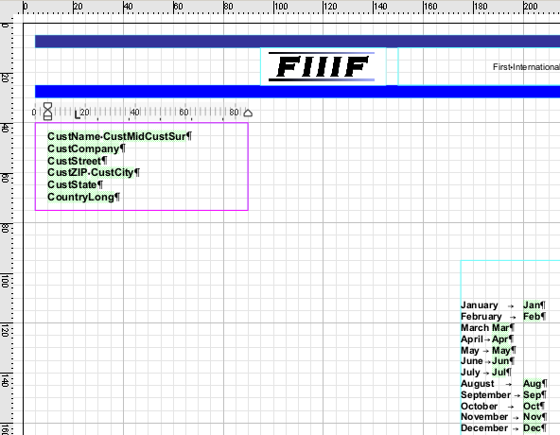
Layout – Text Styles
Create a flow area for address
Insert flow area for the index rates over the last 12 months
Notes:
7) Create a FlowArea for address of the client (rename it to ClientAddressArea), that contains flow (rename to ClientAddressFlow) made up of variables in standard address format.
8) Insert another FlowArea for monthly values of index rates within the last 12 months – type names of months, and after entering a tab space put the variables from the Data node on the corresponding line. (Here, the flow area is re-named MonthlyValuesArea).

Slide 10
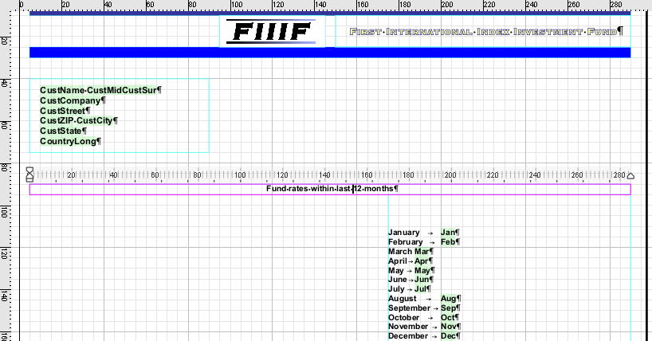
Layout – Text styles
Create a flow area for a title across the middle of the page
Notes:
8) Create a flow area for a title across the middle of the page (MontlyTilteArea) containing flow (MonthlyTitleFlow) with text ”Fund Rates within Last 12 Months”

Slide 11
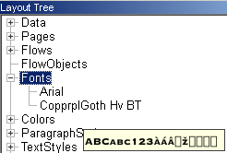
Layout – Fonts
Insert a new font into the Layout
Select menu: Insert | Insert Font and use the browser to find the
font COPGOTHH.TTF in the “SampleTable\Data” directory and Open it.
Notes:
9) We need a special font that is not installed in the windows font folder;
Select menu: Insert | Insert Font and Open the font COPGOTHH.TTF from your “SampleTable\Data” directory.
Note:
Many different types of font can be inserted to your Layout (Raster, TrueType, AFP, etc).

Slide 12

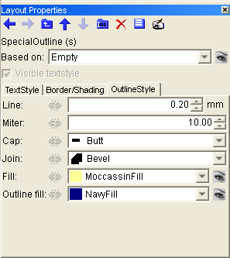
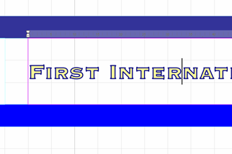
Layout – Text Styles
Create a new TextStyle SpecialOutline
Outline style properties as shown
Apply the new SpecialOutline text style to the content of FundArea
Notes:
10) Use the new font to create a new text style:
Go to the TextStyles node, right-click, and choose Insert TextStyle.
Name it SpecialOutline and open its Layout Properties panel to edit attributes:
Text Style tab Font: CopprplGoth Hv BT; Bold: Yes; Font size: 16; and Outline Style tab as in screen shot above; Line: 0.20; Mitre:10.00; Join: Bevel; Fill: MocassinFill; Outline fill: NavyFill.
11) Apply the new SpecialOutline style to the content of FundArea (use the Style combo-box in the text format toolbar at the top of the window).

Slide 13
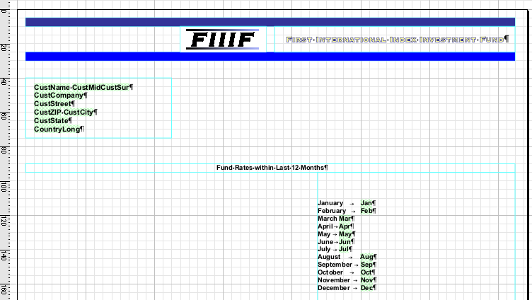
Layout – Text Styles
Create a new text style (AddressTextStyle)
Apply it to the ClientAddressFlow
Create StandardBold text style
Apply it to MonthlyValuesFlow and the MontlyTitleFlow
Notes:
12) Create a new text style (by right-clicking the node TextStyles in Layout Tree) and rename it to AddressTextStyle and give it parameters Bold: Yes; Font size: 12 in the Layout properties panel. Then select content of the ClientAddressArea with the mouse and apply the AddressTextStyle by selecting it in the TextStyle combobox.
13) Create StandardBold Text Style. The properties you can edit in the Layout Properties panel Bold: Yes; Font size: 12 . Apply this style to the content of MonthlyValuesArea.

Slide 14
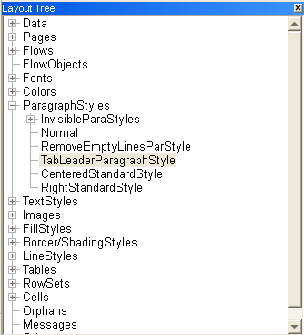
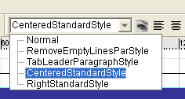

Layout – Paragraph Styles
Create new Paragraph Styles CenteredStandardStyle and RightStandardStyle
Apply the CenteredStandardStyle to the content of the FundArea flow area.
Notes:
14) Create new Paragraph Styles CenteredStandardStyle (A paragraph style which has alignment centred applied) and RightStandardStyle (A paragraph style which has alignment right applied).
Apply the CenteredStandardStyle to the content of the FundArea flow area.
Note:
In the interest of a creating a smaller .WFD file, it is best to avoid using non-specified paragraph styles. So, in the case of applying right alignment, avoid making it with AlignRight button on the ParaStyle toolbar, and apply the style which you have created.

Slide 15
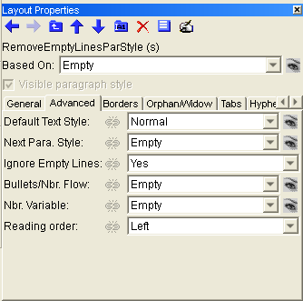
Layout – Paragraph Styles
Create a new paragraph style (RemoveEmptyLinesParStyle)
Set Ignore Empty Lines to Yes (Advanced properties tab)
Apply it to CustomerAddressArea
Notes:
15) Create a new ParagraphStyle (named RemoveEmptyLinesParStyle).
Ignore Empty Lines on Advanced option tab is set to Yes
Apply RemoveEmptyLinesParStyle to the CustomerAddressArea flow area. Similar to applying a text style, simply select the content on which you want to apply the ParagraphStyle and apply it using the Paragraph Style combo-box also available from the toolbar at the top of the window (by default, to the right of the text style combo-box).
This makes sure that if any field is left empty in the data input (e.g., CustStreet -customer’s street) it will not show as a gap, but instead the variable below that variable will be following the line above it.
Remember: You can try at this stage proofing your job (by pressing <F6>). If you flick through the proofed pages you will see that the content and number of lines in the CustomerAddressArea vary.

Slide 16
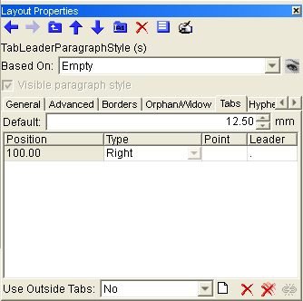
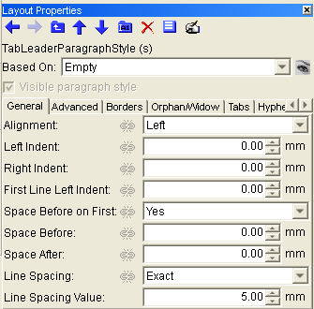
Layout – Paragraph Styles
Create a paragraph style (MonthlyValues)
Line Spacing: Exact with value 5mm
Apply the style to the MonthlyValuesArea
Customize the Tabs tab
Notes:
16) Create a paragraph style for the monthly values (MonthlyValues) lines, where month names and values are separated with a tab space.
In Layout Properties set Line Spacing: Exact with value 5mm
On the Tabs tab of the Layout Properties panel create a new tabulator definition (click on the Create New icon to add a row), spaced (Position) 100mm. You can select among various types of tabulators. Select Right and specify a full-stop “.” as the Leader, so that tabulator blank space will be filled with dots.
Apply this new paragraph style to the lines with monthly values (MonthlyValuesArea flow area)

Slide 17
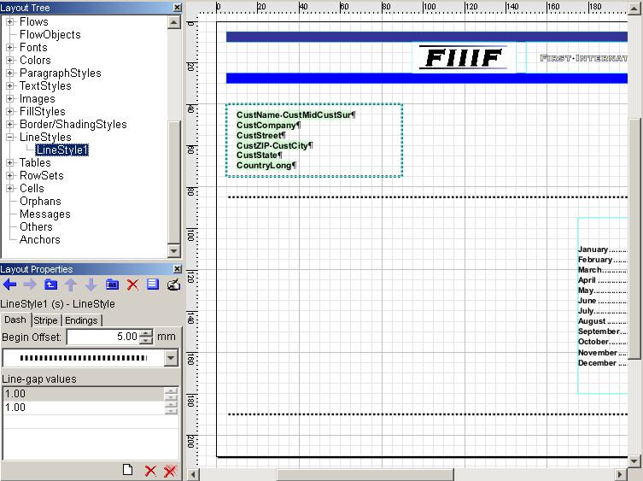
Layout – Line Styles
Create a new line style
On its Dash tab, insert values for line-space, see that many
values may be inserted
Draw a line using the Line tool and apply the new line style to
this line (Content tab)
Copy the line and paste the line again at the page bottom
Notes:
17) Create a new line style (right-click on LineStyles node select Insert Line Style).
Using the Dash tab of the Layout properties panel, insert values for the line/space (click on the create new icon to add a row). Many values may be inserted, the first row in the table is the length of the first drawn line, the second row is the length of the gap, the third is again the length of the next line, allowing the creation of line styles with multiple size lines and spaces.
A preview of the line, as currently defined, is visible in the combo-box above the table, you can also select here from a selection of pre-defined lines.
Begin Offset is after what distance the first line will be drawn. If set to 0.00 then the line style (first solid line) will start at the beginning of the line that it is applied to.
The Stripe tab allows you to set the width of the drawn line and the Endings tab allows you to set an end type (e.g., arrow) to appear at the very end of the whole line.
18) Draw a line across the LandscapePage and apply this new line style to it.
Copy the line and paste the line again at the bottom of the page.

Slide 18
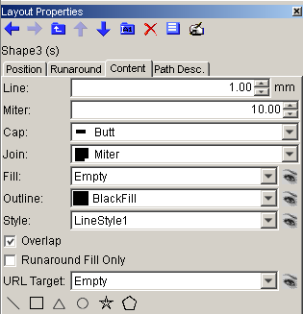
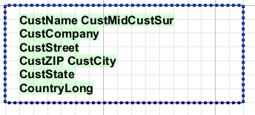
Layout – Line Styles
Create a rectangle using the Shape tool and apply to Style the LineStyle you have just created in step 18
Stretch the rectangle over the CustomerAddressArea so that it appears as a border around it
Notes:
19) Create a Shape with specified parameters (as displayed in the screen shot ) in Layout Properties (Line: 1.00; Fill: Empty; Outline: BlackFill ) and apply as its outline Style the LineStyle you have created before in step 18.
Note:
Strictly speaking, this method of creating a border around a flow area is not necessary and is an inefficient approach. You can instead apply a borderstyle directly to the flow area’s properties. However, we are using it here to familiarize ourselves with the relationship between line styles and shape properties.

Slide 19
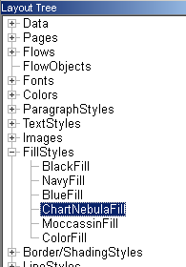
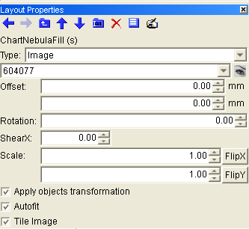
Layout – Fill Styles
Insert image
Create a new fill style
Notes:
20) Insert the image 604077.jpg from the folder provided with this task (Insert | Insert Image).
21) Create a new FillStyle (by right-clicking FillStyles node) that uses that image.
Name it ChartNebulaFill and select the parameters as displayed in Layout Properties. The Type of fill is Image, then select the Image 604077 which will be listed in the combo-box (all inserted images are listed to select from) .
We will be using this fill style later to fill the bars of a Chart.
Note: If you modify any style, then the changes will be applied in all locations in Layout design where that style is used.

Slide 20
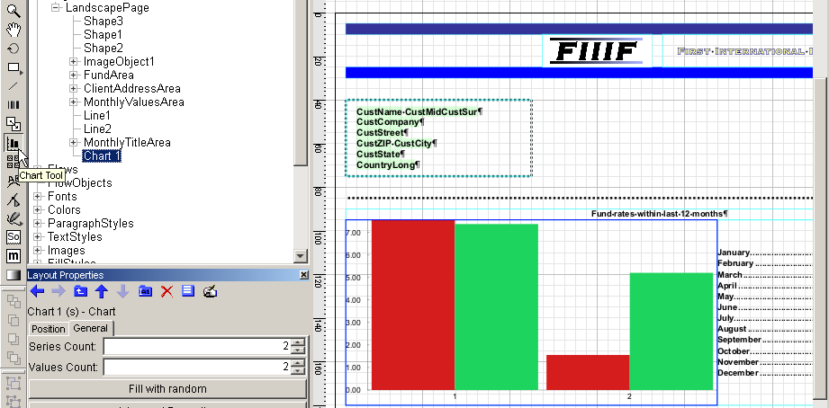
Layout – Charts
Draw an area to contain a chart in the Layout Area using the Chart tool
Layout Properties panel; switch to tab General and click on the Advanced button
Notes:
22) Draw an area for a chart using the Chart tool available from the tool bar and using your mouse (in the Layout Area).
By default an example chart is displayed in this area.
To modify it (to relate it to our 12 monthly values) go to the chart’s Layout Properties panel switch to the tab General and click on the Advanced button.

Slide 21
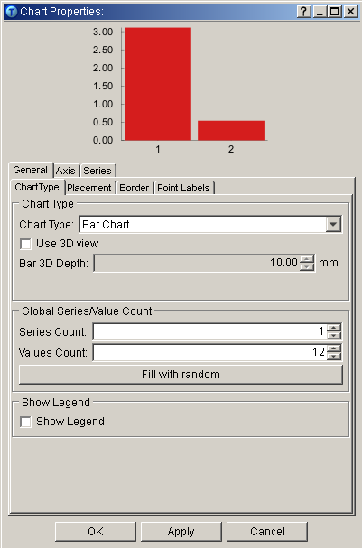
Layout – Charts
Select Chart Type: Bar type graph
We need to depict 12 months’ values in 1 series of bars
On the Point Labels tab check Use Point Labels
This will show the values that are represented on the graph
Notes:
23) We will use the default vertical bar type graph (graph types can be selected from the Chart Type: combo-box: menu on the Chart Type tab).
As we are going to use the chart for depicting values over twelve months of values in one simple series of bars, we will define 12 values in 1 series of bars.
Enter Series Count: 1; Values Count: 12
On the Point Labels tab you should check Use Point Labels.
This will show the values that the graph represents on the graph. you can further alter the position of the label in relation to its corresponding bar using the other attributes on this tab).

Slide 22
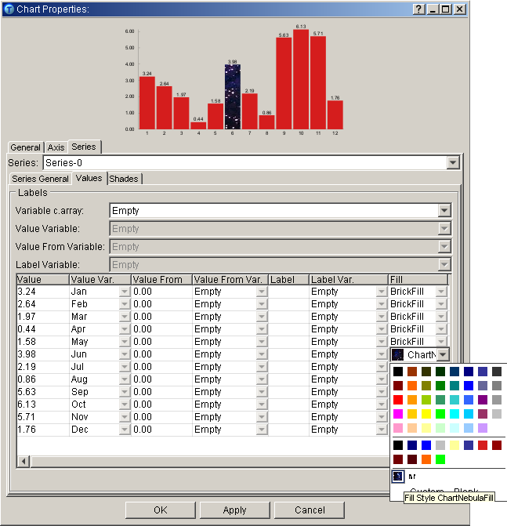
Layout – Charts
Values are assigned to the chart on the Series tab | Values sub tab
In the Value Var. column assign the consecutive month value
Variables
Change the Fill of all bars to ChartNebulaFill
Notes:
Values are assigned to the chart on the Series tab | Values sub tab
There are rows for each of the 12 values of the Values Count.
24) Assign monthly values to all of the bars in the Value Var. column. Select the month value variables that are from the input data records monthly values to all Chart bars using the drop-down menu.
Note: Ignore the values in the Value column when using variables to define the values. The values shown there are simply example values which are used to create the preview above, they do not relate to the data from the input data file.
In this tab you also define what the fill style of each bar will be.
In the Fill column for all bars select our created fillstyle ChartNebulaFill from the drop-down menus.
Now is another good time to proof your work. Press <F6>.

Slide 23
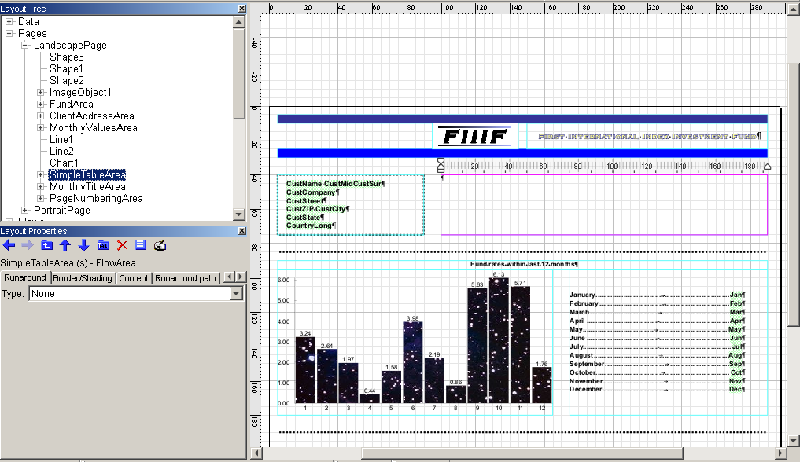
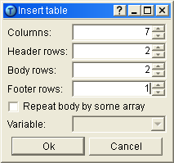
Layout – Tables
Create flow area (SimpleTableArea) containing SimpleTableFlow
Select the flow and insert a table: Insert|Insert Table
Define the table as in the screenshot below
Notes:
25) Create a new flow area (named SimpleTableArea) containing a flow (named SimpleTableFlow).
Select the flow area to make sure the Flow Area tool is still selected;
go to: Insert|Insert Table.
The Insert table dialog opens.
Specify the properties of table to be inserted: We need seven columns, one for row description and six for Variable Data fields; we will need two header lines; one for table title and one for column names; Then two body lines, one for Transaction Rates, one for Last Rates of the Fund and then a single bottom Footer Line will contain information about the Investment Amount.
Click on OK

Slide 24
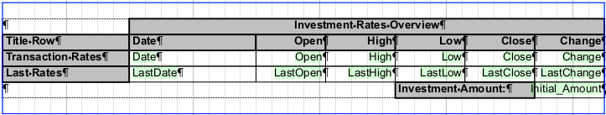
Layout – Tables
The table is inserted in the flow area, below is a preview of how it should look
Write titles to the header rows, footer row, and first column.
Notes:
The table is inserted across the width of the flow area.
26) Referring to the preview screenshot on the slide, format the table:
Write titles to the header rows, footer row, and first column.
To adjust the widths of cells by mouse, make sure the FlowArea is selected with the FlowArea tool and hold down the <Ctrl> key. If you move the mouse above the column separator line, you will see the column adjusting cursor. With <Ctrl> still pressed, click and hold the left mouse button and move the mouse to modify the column width.
You can also use the Distribute Columns Evenly option from the right click menu when multiple columns are selected or adjust cell sizes accurately using the Table Properties dialog.
To merge the title and footer cells, select the cells that you want to merge and right-click. Then select from the menu Merge Cells.
Drag and drop data variables from the Layout Tree to the cells (the variables are those highlighted in green in the screenshot above).
Notes:
Increasing the width of the columns also affects a merged column – if you do not set a proper width and height of Merged lines too, you might get "Horizontal overflow" warnings in output.
If you intend to create a table with precise cell sizes using the Table Properties dialog, set the Cell properties before merging cells. Chancing the properties later is possible, but in complex tables with many merged cells could be tricky to calculate the correct sizes.
In our table used to create our task we used the following properties:
FlowArea width is 190mm, following settings were used:
Cell height 5mm all
Title and Date column width - 40mm
Open, High, Low, Close, Change column width - 22 mm
Investment Rates Overview cell width - 150mm
Blank bottom cell width - 124mm
Investment Amount cell width - 44mm

Slide 25
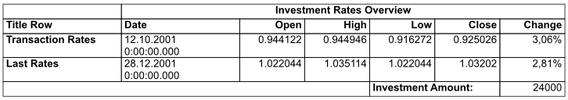
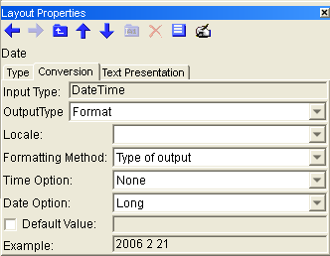
Layout – Converted Variables
Proofing now (<F6>) would reveal that the format of the date variables are not in a good format:
We must convert a variable
Select the variable Date and on the Conversion tab
Repeat for variable LastDate.
Notes:
Proofing now (<F6>) would reveal that the format of the date variables are not in a good format and so remembering how to convert a variable’s format from our first task (A Sample Letter):
27) Select the variable Date from in the Layout Tree to open its Layout Properties dialog. Got to the Conversion tab and set:
OutputType: Format
Time Option: None
Date Option: Long
28) Repeat step 28 for variable LastDate
You can see how the date format will look in the Example box at the bottom of the tab.

Slide 26
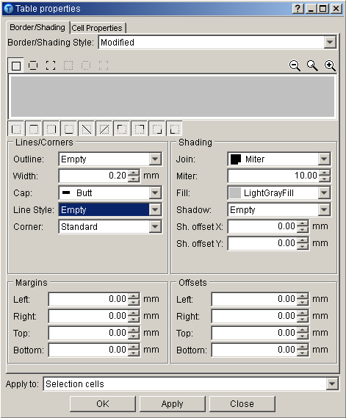
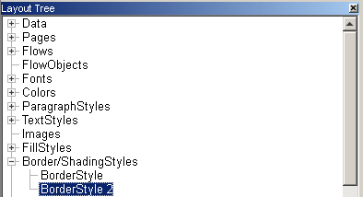
Layout – Table Format
Select all cells and open the Table Properties dialog
Borders/Shading tab: Define an Outline and Width
Click on Apply and a new border/shading style appears in the Layout Tree
Notes:
Finally, to format the borders and shading of the cells of the table. Remember that when we adjust styles we actually create new styles and it would be best to organize and name the new styles that we create.
29) Select all of the normal cells of the that contain the variables and from the right-click menu select Table Properties (which will open the Table Properties dialog for those cells). On the Borders/Shading tab you can define an Outline for the cells with any Width that you choose. This will apply a border to the cells.
You will note that in the Border/Shading Style combo-box at the top of the dialog it now shows Modified (previously it showed Empty meaning none selected) to indicate that a new style is being created.
Click on the Apply button and a new border/shading style BorderStyle will appear in the Layout Tree. Rename it to TableBodyStyle.

Slide 27
Layout – Table Format
Select title cells and open the Table Properties dialog again
Border/Shading Style select TableBodyStyle
Adjust the line Width and a Fill of grey and click on Apply
Notes:
30) Now select some of the title cells and open the table properties dialog. In the Border/Shading Style combo-box select TableBodyStyle.
Adjust the line Width to be thicker (again you will note that in the Border/Shading Style combo-box shows Modified) and in the shading area format these cells with a Fill of light grey.
When you click on Apply another new Border/Shading style is created. Change the name of the style to TableHeaderFooterStyle.
Apply this style to all title cells by selecting the cells and selecting the Border/Shading Style in the Table Properties dialog.
The design of out LandscapePage is now complete. You can try proofing (press <F6>) to check that so far is so good!

Slide 28
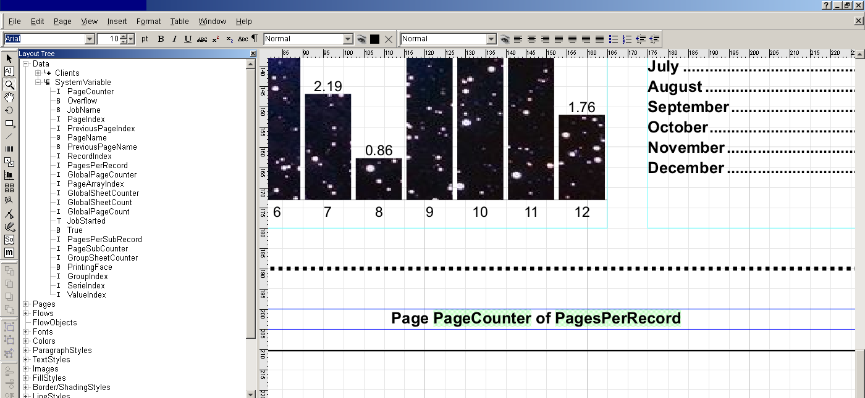
Layout – System Variables
Create a new flow area along with the bottom of the page
Drag and drop the system variables PageCounter and PagesPerRecord also type Page and of.
Notes:
System variables: are automatically generated in every layout and can be useful for certain design features and page order logic. We will use two of these variables to add a simple page identifier to a footer at the bottom of the page:
PageCounter - starts with value 1 for the first page, is incremented on each new page within one record. For new record, starts again with value 1.
Pages per record - generated during page preprocessing, returns total number of pages in the current record.
31) Create a new flow area along the bottom of the page.
Drag and drop the variables PageCounter and PagesPerRecord and then also type Page in front and of in between them.
Note: After inserting these variables you will see only default values "0". To make the variables display their names, select them in the Layout Tree and in their Layout Properties panel select Display: Name

Slide 29
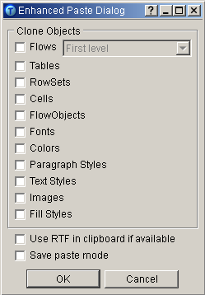
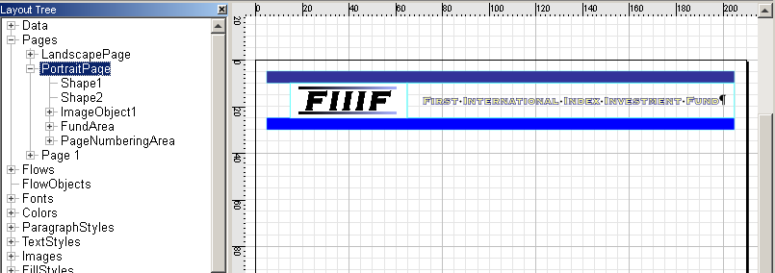
Layout – Copy and Paste
Create a new page and name it PortraitPage
Copy the header objects of the LandscapePage (Select objects + Edit|Copy)
Enhanced paste (Edit|Enhanced Paste) deselecting Flows
Arrange the objects to fit the page
Notes:
32) Create a new page (Pages node right-click menu) to start our design for the portrait page and name it PortraitPage.
Insert the same header as is on the previous page, you can simply copy (select header on LandscapePage and then Edit|Copy or <Ctrl> + <C>) and Enhanced Paste from the Edit menu. On the Enhanced Paste dialog that appear, deselect the Flows check-box and now the pasted item will be the very same flow (FundFlow) and not an independent one (i.e., changing the properties of FundFlow will change the properties of the FundFlow on both pages).
You can alter the size of the flow area, the position of the text, and the rectangle shapes to fit the page without affecting the LandscapePage, but the actual flow FundFlow, its styles and the image FIIIF only exist once in the Layout and there properties must be altered centrally.
Note: Page position objects (Flow areas, shapes, lines, etc.) are described in relation to their page and therefore when you paste them to new position a new object has to be created. Other static objects (images, flows, styles etc.) are independent of the page and so when you paste them to a new position no new object is created. This feature of non-position objects is very useful to keeping the size of the .WFD file you create as small as possible and to edit them in multiple locations at one time.

Slide 30
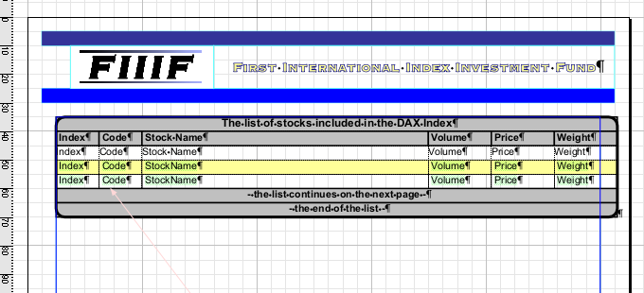
Layout – Repeated Tables
Draw a large flow area to fill the rest of the page (StocksTableArea) rename the flow inside (StocksTableFlow)
Inside this flow will be the table to contain values of all the stocks that are part of the customer’s fund. One page will not be enough for some customers and so this table must be able to overflow on to other pages if needed.
Notes:
33) Draw a large flow area to fill the rest of the page (StocksTableArea) rename the flow inside (StocksTableFlow).
Inside this flow will be the table to contain values of all the stocks that are part of the customer’s fund. One page will not be enough for some customers and so this table must be able to overflow on to other pages if needed

Slide 31
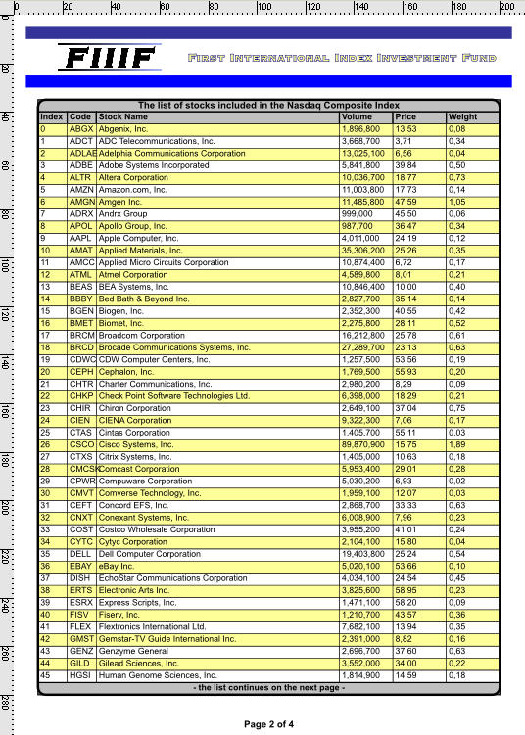
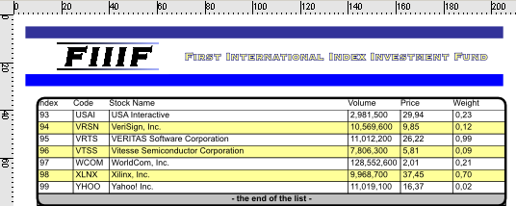
Layout – Repeated Tables
We require:
Header rows for a title and column titles
Body Rows to print the stock data row-by-row
Footer rows for info that either “the list continues on the next page” or it is “the end of the list”.
Notes:
When inserting a table we should first think about how we want it to look and what we need it to contain.
Remember:
In step 1 of this exercise we stated that CustOption was going to be the key field (it appears in both the Clients and Stocks data files) and if a customer has CustOption 1 then they will receive info about all stocks with CustOption 1 marked. Now we are defining that as long as there are more stocks (with the same Stock CustOption as the customer’s CustOption) in the data file then we will keep adding rows to the table until all of the stocks are printed, i.e., repeating the same rows with all the same variables for each Stock.
So, on each page we need to print out:
- the stock data row by row [1 repeated body row]
- A header row to contain column titles and/or a general title [1 header row]
- Footer rows for information that either “the list continues on to the next page” or it is “the end of the list” [1 footer row].

Slide 32
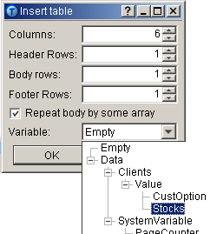
Layout – Repeated Tables
Insert a table into the flow
Check Repeat body by some array
Variable: Stocks
Notes:
34) Insert a table into the flow (Select the flow and Insert|Insert Table).
In the Insert Table dialog define: Columns: 6; Header Rows: 1; Body Rows: 1; Footer Rows: 1 and check the Repeat body by some array option. In the Variable combo-box, which then becomes active, select the variable Stocks.
Click on OK.
Because of our data merging, the Stocks variable is actually an array within the Clients data and so you are repeating by an array.

Slide 33
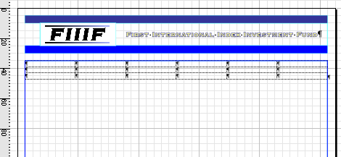
Layout – Repeated Tables
A table of 3 rows is added to the flow area
Notes:
A table of 3 rows is added to the flow area.

Slide 34
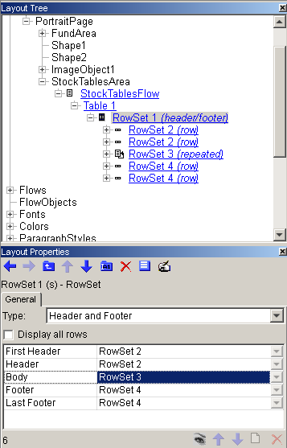
Repeated Tables – Rowsets
Now look in the Layout Tree:
5 rowsets have been created as PrintNet T adds secondary Header and Footer rows for table overflows:
FirstHeader row for the very beginning of the table
Secondary Header row for table continuations in different places (duplicate)
Body Row (repeated)
Secondary Footer row for table continuations (duplicate)
Last footer row that appears at the very end of the table
Notes:
You will note that it has 5 rowsets have been created whereas you only asked for 3 rows (1 header, 1 body, 1 footer). This is because PrintNet T assumes that the table will overflow into other flow areas and therefore when you ask for a FirstHeader row for the very beginning of the table and it also adds a secondary Header row for table continuations in different places.
Similarly with footers, you make a Last Footer that appears at the very end of the table and it adds a usual Footer row for instances where overflow is required.
By default these added headers and footers are duplicates and whatever content is placed in one is also in the other. However, these are 5 separate rowsets and the content of each can be altered separately.

Slide 35
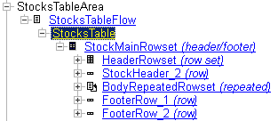
Repeated Tables – Rowsets
Rename the rowsets in the Layout Tree
Notes:
35) Now is a good time to rename the rowsets in the Layout Tree to avoid confusion (refer to the screenshot above for an idea of how to name them)

Slide 36
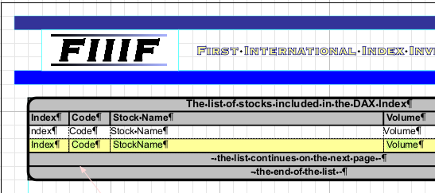
Repeated Tables – Rowsets
We will use the structure on the left of the slide above to create the design in the screen shot on the right

Slide 37
Repeated Tables – Rowsets
The table is made up of rowsets, this enables more than row to act as a single row. Therefore, we can add more rows to our first header to appear when required.
On the first page of out customer’s table we would like to show a title as well as the column headings:
The above 2 rows will be part of 1 rowset.
Notes:
The table is made up of rowsets as opposed to just rows, this enables more than row to act as a single row. Therefore, we can add more rows by editing a single rowset and when that rowset is called it will show all of the rows added to it.
On the first page of out customer’s table we would like to show a title as well as the column headings. We can add a row for the title to our first header rowset (HeaderRowset).

Slide 38
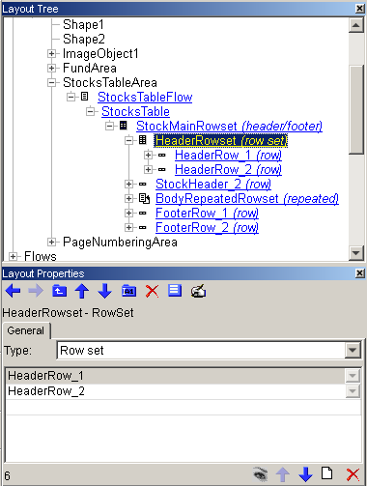
Repeated Tables – Rowsets
Select HeaderRowset and change Type to Row Set
It will now contain a new rowset of type Row. We need two of these:
Click on the Create New icon to add a new rowset of Type: Row.
Rename both of these rows.
Notes:
36) Select the HeaderRowset and change its Type to a Row Set.
It will now contain a new row set of type Row. We need 2 of these rows in our HeaderRowset:
Click on the Create New icon to add a new Row of Type: Row Set.
Rename both of the rows

Slide 39
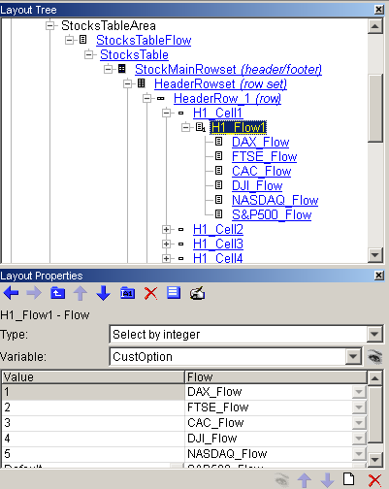
Repeated Tables – Rowsets
In the first Row (HeaderRow1) add a title flow:
A conditional flow that will return 1 of 6 possible titles according to the variable CustOption
Create a conditional flow inside the first cell of HeaderRow1
Add the Values 1-6 and add 6 different title flows according to the stock option.
Notes:
Now we want to add our title to the first row set (HeaderRow1) but we want our title to be different for each of the Customer Share Options (variable CustOption). So we must enter a conditional flow into one of the cells that make HeaderRow1.
Remember: We set a conditional flow in our previous task (A Sample Letter).
37) Inside HeaderRow1 there should be 6 cells (1 for each of the columns we defined) choose the first cell (Cell 1 [rename it to H1_Cell1]) and inside it will be a flow (Cell1 Flow [rename it to H1_Flow]).
When this H1_Flow is selected you can choose the flow Type: Select by integer and the Variable: CustOption (remember that CustOption is a variable that returns an integer [1-6]) and add 6 rows to the table with the Create New icon.
Enter values 1 through to 6 in the Value column and for each value create a new flow (select Create New Flow from the drop-down menu in the Flow column) Rename the newly created flows in the Layout Tree and select and edit them, one-by-one, to contain the following texts:
The list of stocks included in the DAX Index
The list of stocks included in the FTSE 100 Index
The list of stocks included in the CAC 40 Index
The list of stocks included in the Dow Jones Industrial Index
The list of stocks included in the Nasdaq Composite Index
The list of stocks included in the Standard & Poor's 500 Index

Slide 40
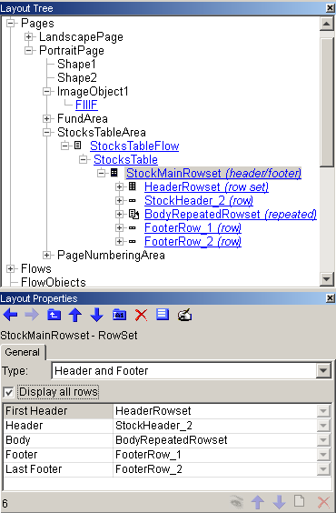
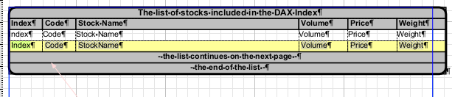
Repeated Tables – Format
Select the StockMainRowset and check Display all rows
Add the 6 variables to the BodyRepeatedRowset
Merge header and footer cells and set titles and column headers
Set up column widths and a precise cell height of 5mm.
Notes:
38) Select the StockMainRowset from the Layout Tree and check Display all rows in its Layout Properties panel.
Now you will see all 6 rows displayed on the page in the Layout Area (2 for the first HeaderRowset, 1 for the secondary StockHeader, 1 for the BodyRepeatedRowset, 1 for the usual FooterRow_1 and 1 for the final footer row 2). All of these rows will be visible at some point in the table when our task job is printed. This means we should fill the rest of the intended content and format the cells:
Add the variables Code, StockName, Volume, Price, Weight and Index (that will be generated as a system variable together with the Repeated node) to the BodyRepeatedRowset, arranged as shown in the screen shot above.
Merge the cells first header and the footer cells and type in the titles to the header and footer rows.
Set up column widths and a precise cell height of 5mm (using the Tables Properties dialog).
Format the table by selecting the TableBodyStyle and TableHeaderFooterStyle as created for the Landscape page.

Slide 41
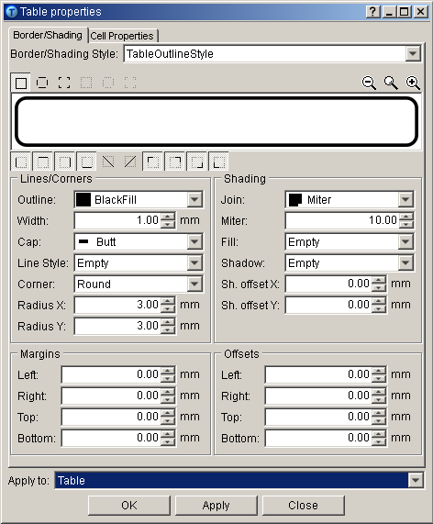
Repeated Tables – Format
Format the table by selecting TableBodyStyle and TableHeaderFooterStyle
Make a new border style (TableOutlineStyle) for the whole table
Notes:
39) Format the table by selecting TableBodyStyle and TableHeaderFooterStyle to the respective cells.
Make a new border style (TableOutlineStyle) to go around the whole table:
Width: 1 mm; Corner: Round; Radius X and Y: 5mm; Apply to: Table
This will overwrite the borders that are defined for the cells only, to create a separate border that is part of the table as a whole, i.e., selectable in the layout properties panel of the table.

Slide 42


Repeated Tables – Format
For the BodyRepeatedRowset we also want to add a yellow color to every second row printed to make it easier to read:
Select BodyRepeatedRowset. An Index, existing for all repeated rowsets, counts the repetitions of rows
Notes:
For the BodyRepeatedRowset we now want to add a yellow color to every second row to make it easier to read each row:
40) Select BodyRepeatedRowset.
You can see that it has an Index under it in the tree. This exists for all repeated rowsets and it counts all of the repetitions of rows, i.e. it returns the number of each row that is printed. We can use this data to make a useful variable to help us define which rows should be colored.

Slide 43

Repeated Tables – Format
Insert Variable (right-click the
BodyRepeatedRowset node)
Select and rename it (Var_RowSelect)
The boolean variable will now expect a value (0)
Notes:
41) Insert a variable under the Index (using the right-click menu of the BodyRepeatedRowset).
Select and rename it (Var_RowSelect)
Change the Type: to Calculated, Kind: to Boolean and the Value: to False
The boolean variable will now await a value (0) to be returned to it in order for its condition to be met.

Slide 44

Repeated Tables – Format
Write the condition
Select the Code tab of the variable and write the condition shown below
The code means that if the current value of Index is divisible by 2, then 0 will be returned and, therefore, meet the condition of the variable.
Notes:
42) Write the condition.
Select the Code tab of the variable and write the condition:
return Index%2 == 0;
The code means that if the current value of Index is divisible by 2, then 0 will be returned and, therefore, meet the condition of the variable.

Slide 45

Repeated Tables – Format
Select the BodyRow
Type: Select by condition
Add a new row using the Create New icon
Check Display all rows to show these two body rows on the Page.
Notes:
43) Go back to the Layout Tree and select the BodyRow and change its Type to Select by condition.
Add a new row using the Create New icon:
Variable: Var_SelectRow
Rowset: Create New Rowset of Type: Row (Row_Color_1)
The original default row needs a new row as well:
Variable: Default
Rowset: Create New Rowset of Type: Row (Row_Color_2)
Check Display all rows to show these two body rows on the Page.

Slide 46

Repeated Tables – Format
Seven rows are displayed on page (2 body rows instead of 1)
Format one of the body rows yellow using the Table properties dialog.
Notes:
Now 7 rows are displayed on the page (2 body rows instead of 1):
44) Format one of the body rows yellow by selecting it in the Layout Area using the Table properties dialog.

Slide 47

Overflow
Now we will enable the table on the Portrait page to overflow to other pages of the same design if required
Select the node Pages from the Layout Tree and choose Variable selection from the combo-box menu
Notes:
Now we will enable the table, on the Portrait page, to overflow to other pages of exactly the same design, in case it is required.
45) First select the node Pages from the Layout Tree and choose Variable selection from the from the first combo-box menu.
Note: Note that by default the first page of a print job (the Start Page option on the General tab of the Pages node) is set to be the first page down the tree. In this case it is the LandscapePage. As our job will start with the Landscape page for each customer we will leave the default StartPage. The order of the other pages of the print job will be specified on the individual pages, not on this general node.

Slide 48

Overflow
Select LandscapePage and specify conditions on Next Page tab according to screenshot
The LandscapePage will always be followed by PortraitPage
Notes:
46) Select the LandscapePage in Layout Tree. Switch to Next Page tab and select from the combo-box menus that the LandscapePage will be followed by a page selection of the Type: Simple to the Page: PortraitPage (PortraitPage should already be selected by default).

Slide 49

Overflow
Select PortraitPage and on the Next page tab select the page selection Type: Select by Condition
Add a row using Create New icon and set condition according to screenshot
If the page overflows it will go to the same page again
Notes:
Now to our Portrait page, where we want to keep repeating that Portrait Page is followed by PortraitPage as long as the table still needs to overflow.
47) Select PortraitPage and on the Next page tab select the page selection Type: Select by Condidtion
Add a variable by clicking on the Create New icon and in the Variable column select the system variable Overflow from the drop-down menu.
The Overflow variable simply returns True if the page content will overflow.
In the Page column select the same PortraitPage and leave the Default row to be Empty.
Now we have defined that if there is overflow still to print then the next page to be printed should be PortraitPage but if there is no more content do nothing (in this case doing nothing means print the next customer’s record starting with landscapePage again).

Slide 50

Overflow
We must also will select what content it is that we want to overflow
Select the Flow Area tool and double-click in the StocksTableArea flow area
An arrow mark will appear across the flow area to show that it is set to overflow.
Notes:
Finally for overflow definition, we must select want content it is that we want to overflow to the defined following pages.
48) Select the Flow Area tool and double-click in the StocksTableArea Lflow area
An arrow mark will appear across the flow area to show that it is set to overflow.

Slide 51
Footer
Copy and paste the footer flow area from the LandsapePage to
the bottom of the PortraitPage
Adjust the width to fit it
Notes:
Finally for our Portrait page design, we must add our footer as we did on the Landscape Page:
49) Copy and paste the footer flow area from the LandsapePage to the bottom of the PortraitPage.
Adjust the width to fit it

Slide 52

Sheet Name
Finally for Layout, we must set each page a Sheet Name so they are identifiable when we pass the design to our output
Enter a Sheet Name: on the Sheet Name Variables tab of both
the LandscapePage and the PortraitPage.
Notes:
Now our design is finished, we will think about output and we will next add an Output module to our workflow, in which we will define our media. Before that, however, we must make sure that we pass the names of our two pages through so that they can be identified and used in the output and production stages. We must give it a Sheet Name:
50) Select each page in the Layout Tree and go to their Sheet Name Variables tab and enter a Sheet Name: (we have called them Landscape and Portrait)

Slide 53

Media Definition
Add an output module and open it
Create a New printing device profile and name it “Stocks”
Click on OK to close the Output module.
Create two new media pages and rename them
Enter page sizes in the Size edit-box
Notes:
51) Return to the Workflow Window, add an Output module to the Workflow Area and connect it after the Layout module:
Open it and add two new media pages to the Media tab (click on the New button at the bottom of the panel). Rename them also to Landscape and Portrait. For each page, enter it’s corresponding size into the Size edit-box (the same size as has been defined in layout in this case but it does not have to be as this should be the actual size of the media to be printed on).
Create a New printing device profile and name it “Stocks”. The AFP Printer Media Configuration dialog opens allowing the setting of advanced options, this time simply click on OK.
Click on OK on the output panel to close the Output module.

Slide 54

Production
Press <F5> to load the workflow to production
Check that the right .WFD file is loaded
Select Engine: AFP to make an AFP type spool file
Browse for a directory to write the spool file to and click Start
Notes:
52) Press <F5> to load the workflow to production:
Check that the right .WFD file is loaded.
Select Engine type AFP to make an AFP type output spool file.
Browse for a directory to write the spool file to in the File Name combo-box.
Click on Start.

Slide 55

Thank You.
Do You Have Any Questions?

